Slide 1
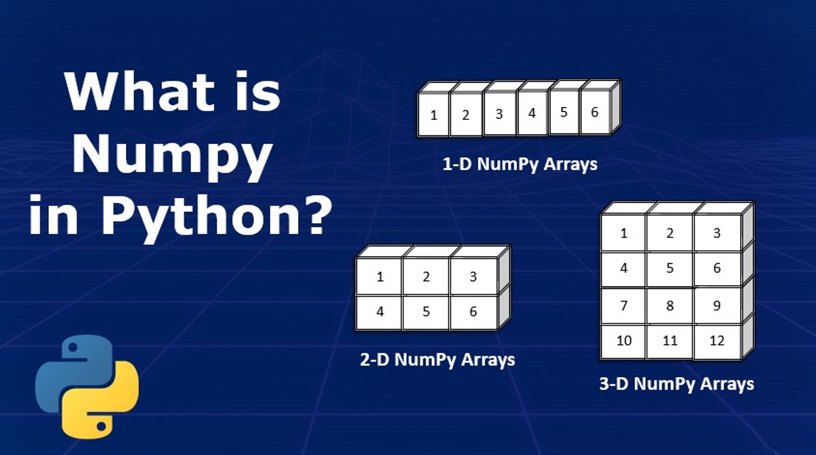

Slide 2
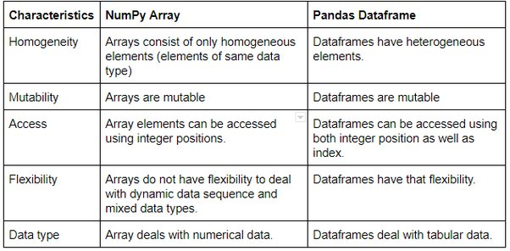
NumPy is a Python library for numerical computing that facilitates efficient operations on arrays and matrices.

Slide 3
Advantages of NumPy:
Efficiency: NumPy arrays are highly memory efficient and provide fast numerical computations due to their implementation in C.
Functionality: NumPy offers a wide range of mathematical functions and operations optimized for arrays, making it ideal for scientific computing and data analysis tasks.
Broadcasting: NumPy's broadcasting feature allows for efficient element-wise operations on arrays with different shapes, reducing the need for explicit looping.
Integration: NumPy seamlessly integrates with other scientific computing libraries like SciPy, pandas, and scikit-learn, enhancing its capabilities for various applications.
Disadvantages of NumPy:
Learning Curve: NumPy can have a steep learning curve for beginners due to its array-oriented programming paradigm and specialized functions.
Homogeneity: NumPy arrays are homogeneous, meaning they can only contain elements of the same data type, which may be limiting for certain applications.
Overhead: NumPy arrays have some overhead associated with them, especially for small datasets, compared to Python lists, which can impact performance in certain cases.
Limited Flexibility: NumPy arrays have a fixed size once created and do not support dynamic resizing, which may be a limitation in some scenarios requiring dynamic data structures.

Slide 4
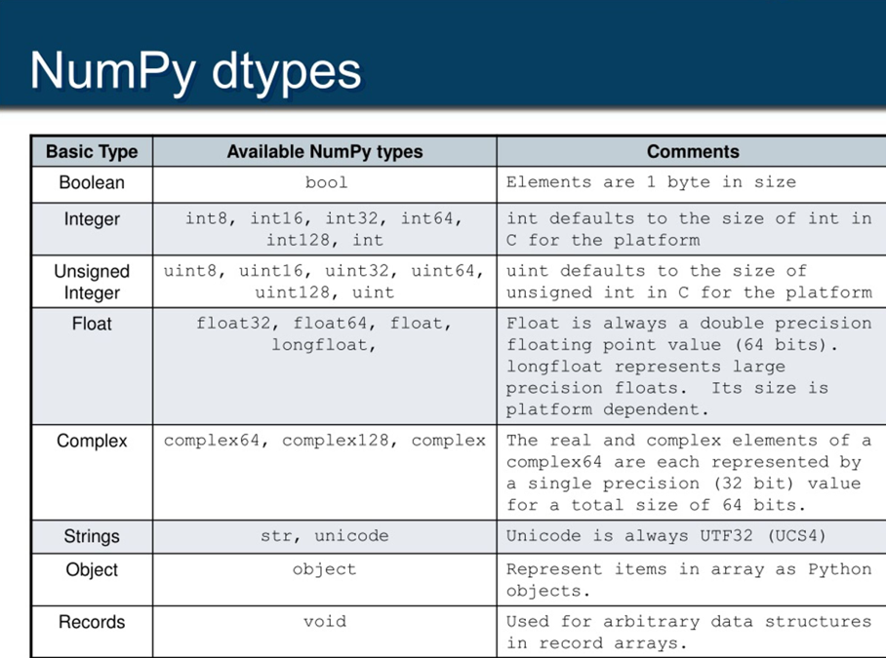

Slide 5


